Slide 1
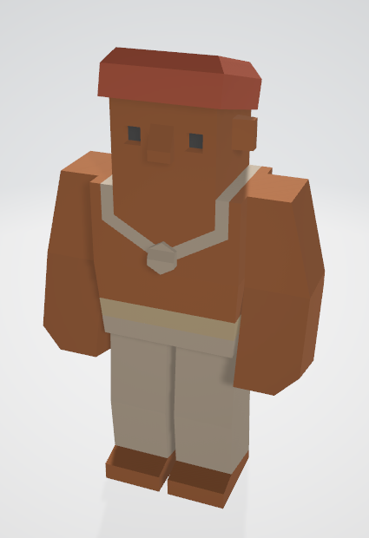
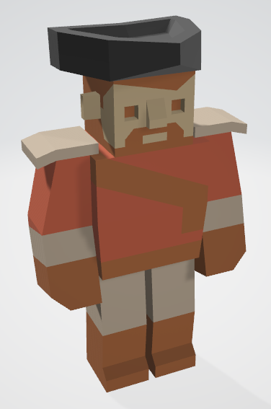
Level 6 – Group 3
Ship Happens
Tom Gibbs
Henry Crofts

Slide 2
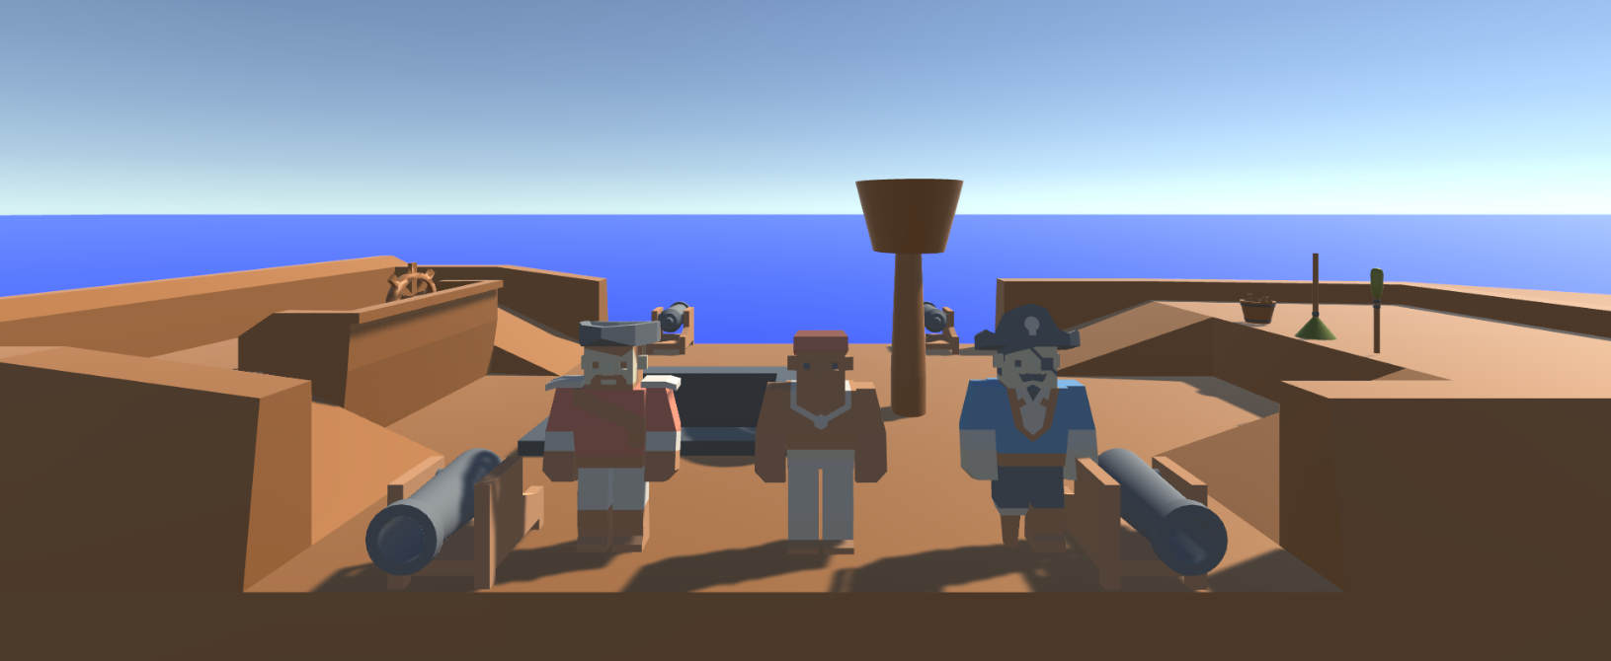
Logline
Local coop resource management game where players must coordinate to resolve hazards and manage activities, figuring out the optimal strategy

Slide 3
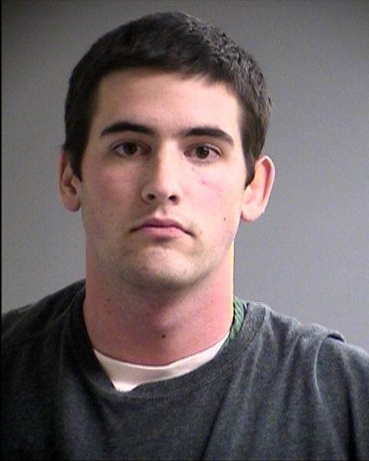
Psychographic
Terry Goldhorn
Aspiring Personal Trainer
Goal oriented / Targets / Progression
Social, plays games and goes out with friends
Student 20 y/o – Sport Sciences
Shared Accommodation
Morning Run / Lectures / Work / Evening Downtime

Slide 4
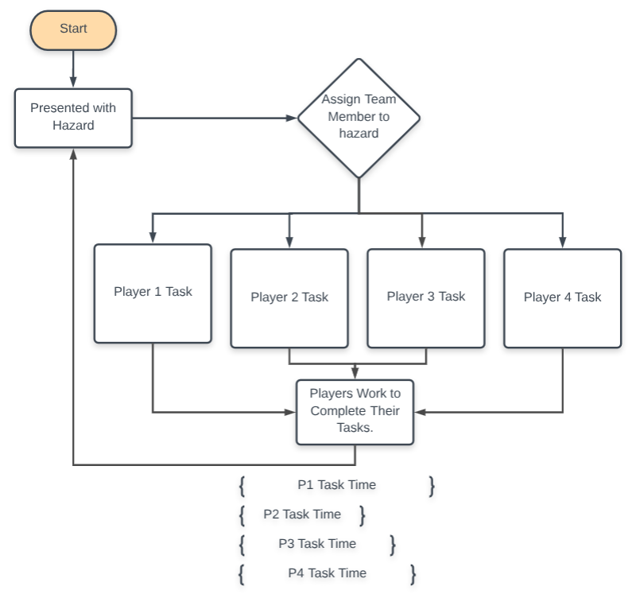
Flow Chart

Slide 5
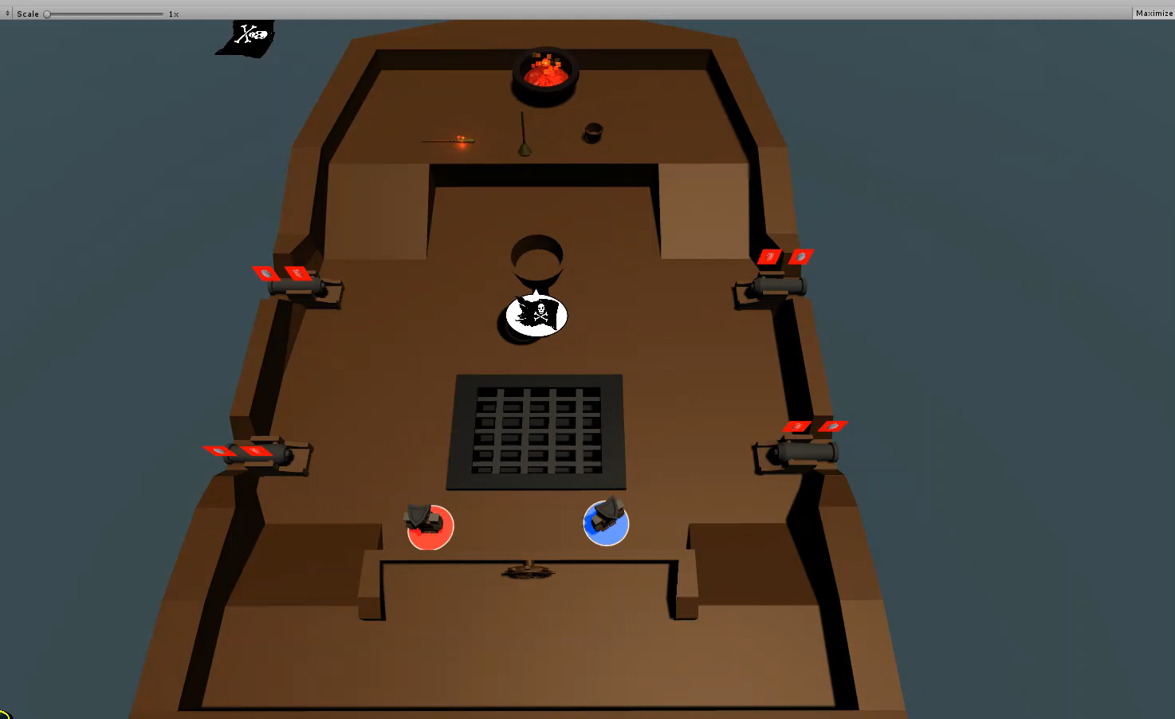
Gameplay: Start – 1min

Slide 6
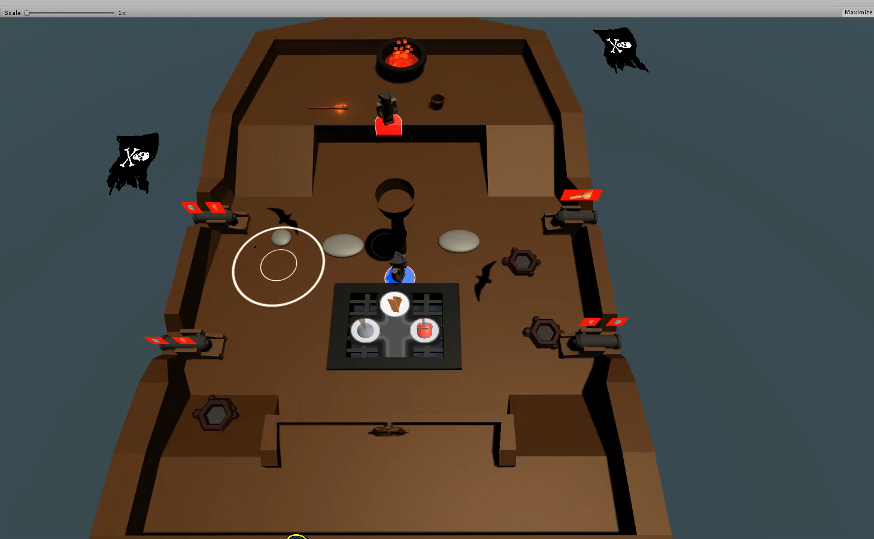
Gameplay: 1min-3min

Slide 7
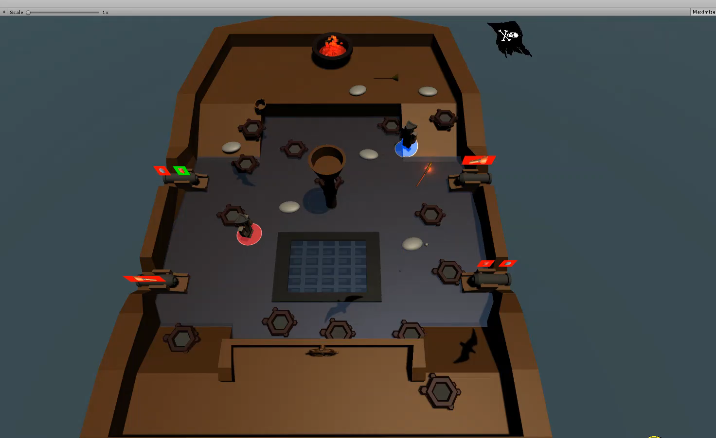
Gameplay: 3min – 4min

Slide 8
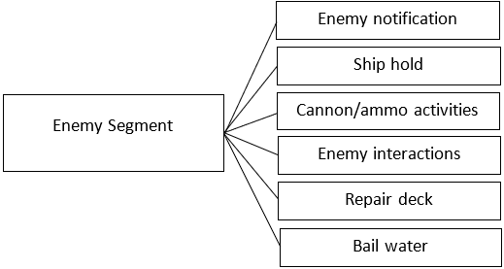
Tutorial
Introduction to game mechanics
Mechanics introduced in segments
Segments separated by free gameplay of introduced mechanics

Slide 9
Tutorial
Enemy Segment
Seagull Segment
‘main level’ equivalent gameplay including only activities from introduced segments
Whale Segment
Rock Segment

Slide 10
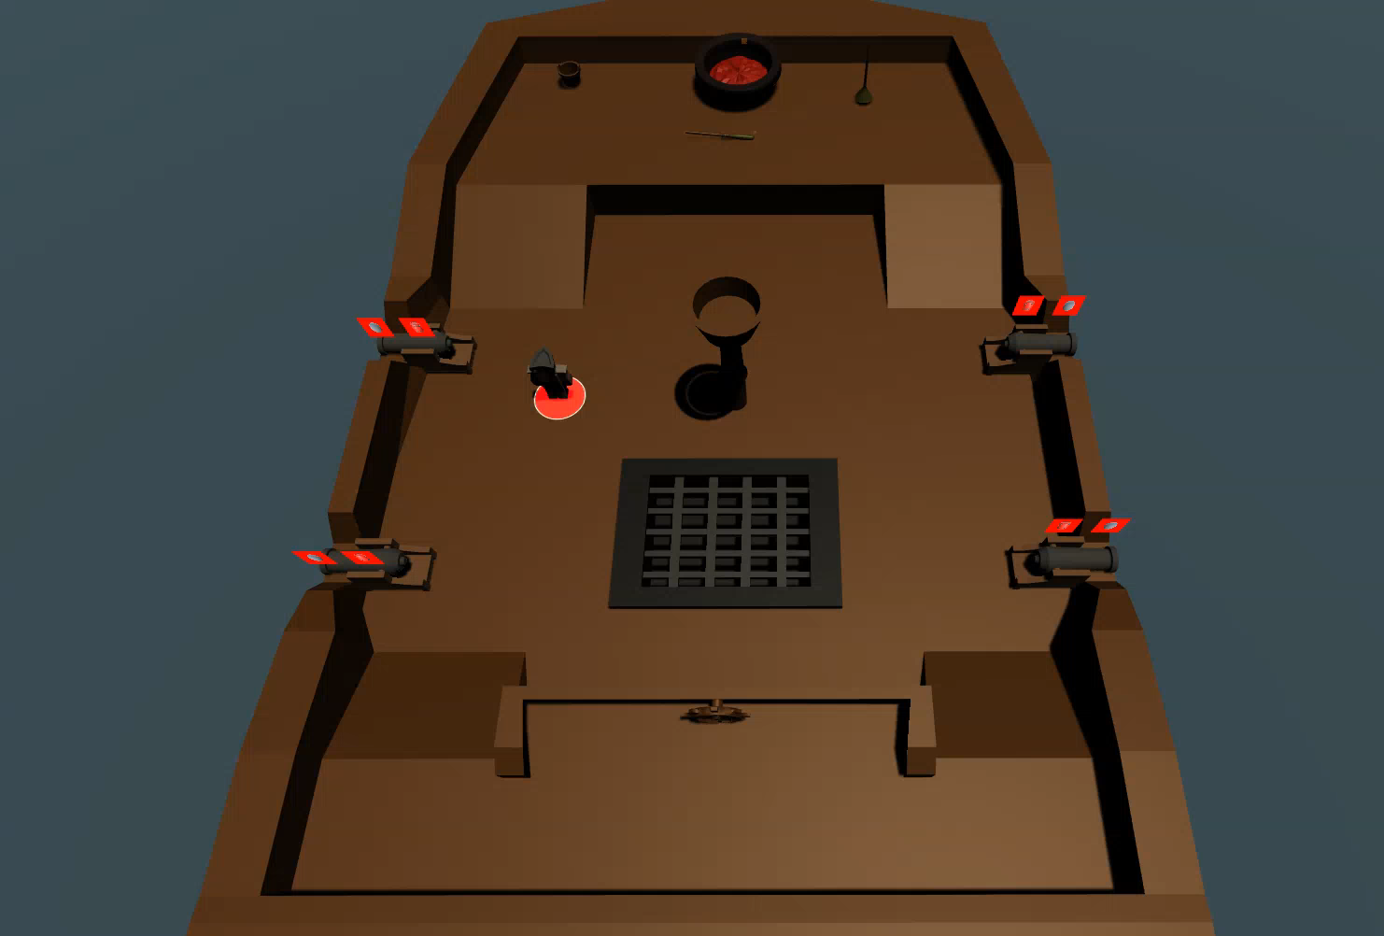
Tutorial, Enemy Segment

Slide 11
Tutorial Playtesting
Need specific questionnaire, will take direction from Jesse Schell’s “The Art of Game Design”, chapter 25 ‘Good Games Are Created Through Playtesting’
Playtesting with the objective of clarifying specific elements

Slide 12
Tutorial Playtesting
Playtest video removed to meet filesize requirements for git commit.
Recording can be found within repository root/Playtesting/Videos/Playtesting for presenteation 28.02.19

Slide 13
Tutorial Playtesting
Playtest video removed to meet filesize requirements for git commit.
Recording can be found within repository root/Playtesting/Videos/Playtesting for presenteation 28.02.19

Slide 14
Tutorial Playtesting
Playtest video removed to meet filesize requirements for git commit.
Recording can be found within repository root/Playtesting/Videos/Playtesting for presenteation 28.02.19

Slide 15
Tutorial Playtesting
Playtest video removed to meet filesize requirements for git commit.
Recording can be found within repository root/Playtesting/Videos/Playtesting for presenteation 28.02.19

Slide 16
Tutorial Playtesting
Playtest video removed to meet filesize requirements for git commit.
Recording can be found within repository root/Playtesting/Videos/Playtesting for presenteation 28.02.19

Slide 17
Tutorial Playtesting
Playtest video removed to meet filesize requirements for git commit.
Recording can be found within repository root/Playtesting/Videos/Playtesting for presenteation 28.02.19

Slide 18
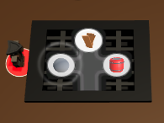
Playtest Feedback
Did not understand the Dpad menu
Did not recognise player had withdrawn item
Suggestions of additional prompts if players progressing slowly

Slide 19
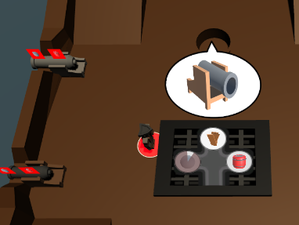
Playtest Feedback
Animation exaggeration
Understood after multiple events, but felt this was too late
Felt like a single-player tutorial

Slide 20
How the Game Has Developed
Game manager to distribute and constrain all activities
Playable main level
Adjusted ship proportions
Telegraphing animations/particle systems
Developing tutorial level
Early playtesting

Slide 21
Remaining Timeline
Tutorial fully functional (18 March 2019)
Playtesting and iteration of tutorial (28 March 2019, Pitch 5)
Playtesting and iteration of tutorial and main level (22 April 2019)
Quests, rewards, player customisation (29 April 2019)

Slide 22
Final Product
Tutorial level which introduces all mechanics
Main level
Stretch goal of implementing rewards, quests and customisation

Slide 23
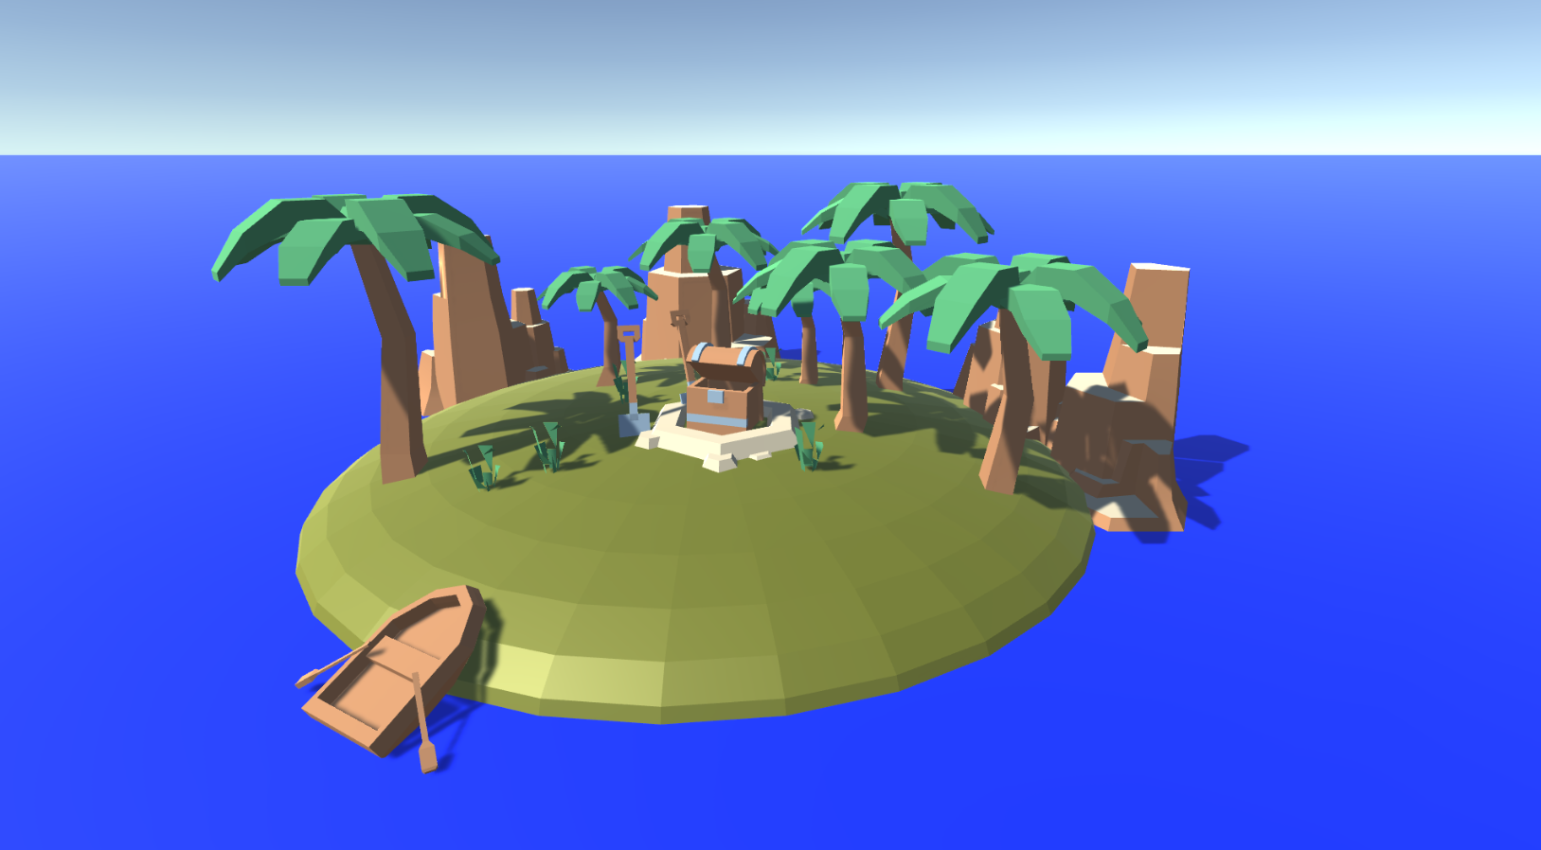
Questions?

